Slide 1
MASTERING (VIRTUAL) NETWORKS A Case Study of Virtualizing Internet Lab
Avin Chen
Borokhovich Michael
Goldfeld Arik
Notes:
Good afternoon.
My name is Michael Borokhovich, I'm a Master degree student at the Ben Gurion University in Israel.
I'm going to present a paper that I wrote with Dr. Chen Avin and Dr. Arie Goldfel.
Our paper describes the case study of developing, deploying and exploiting a virtual computer networks laboratory.
Such a laboratory can be used for teaching Computer Networks and Network Programming courses.
The main contribution of our work is providing an example of using virtualization to create an excellent learning facility along with saving costs, space, and energy.

Slide 2
Agenda
Introduction
Related Work
Virtualization
Virtual Lab Design
Students’ & Administrator’s
Conclusions & Future Work

Slide 3
Introduction
The need for computer networks lab
Computer engineering
Electrical engineering
Communication systems engineering
Notes:
So, why do we need a computer networks laboratory.
We want to learn how do computers exchange the information in the internet, how the routers on the way know the routes to the destination.
We want to learn how to configure those routers and computers to allow them to communicate. In addition we want to measure information rates and many other important papameters.

Slide 4
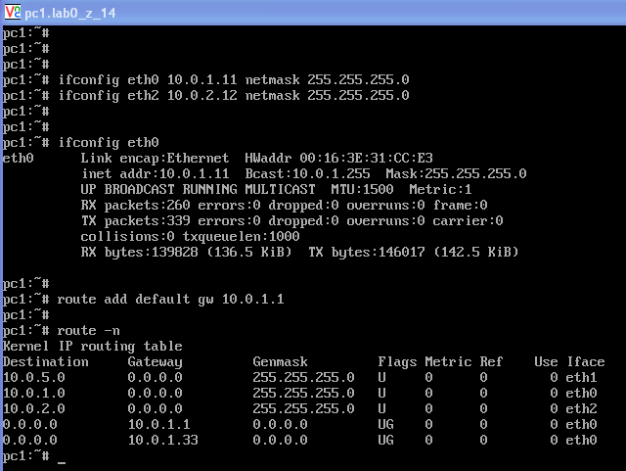
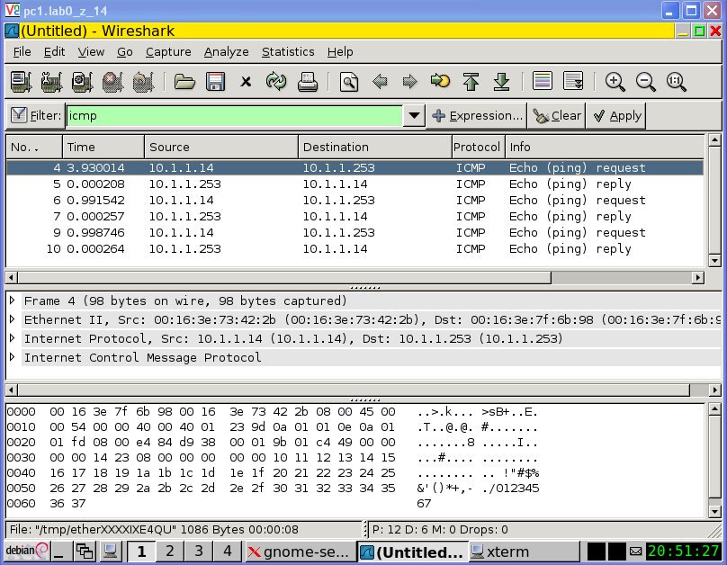
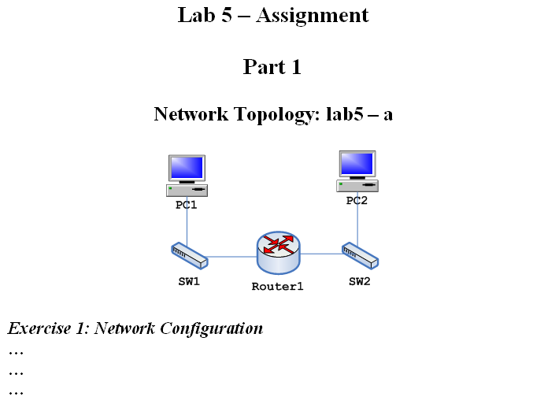
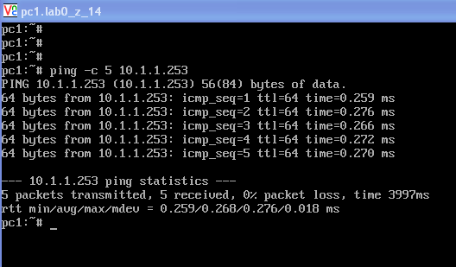
Working in Network Lab
Assignment document
Build network
Configure devices
IP Addresses
Routing protocols
Send messages
Capture messages
Take measurements
Notes:
Before each lab session – assignment document with instructions
Capture messages (investigate message fields)
Take measurements (time…)

Slide 5
Related Work
Physical (real) lab
Simulation
Emulabs
Virtualization (MLN, VMware, Virtual PC)
5

Slide 6
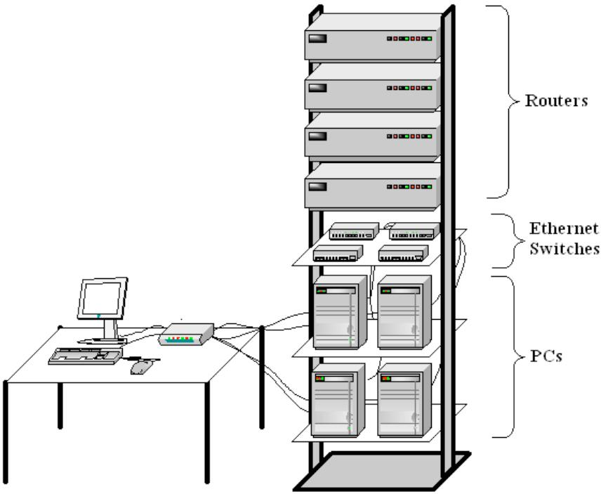
Physical (real) laboratory
Pros:
Real equipment
“Hands on”
Cons:
Cost
Space
Time
Energy
6

Slide 7
Related Work
Physical (real) lab
Simulation
Emulabs
Virtualization (MLN, VMware, Virtual PC)
7

Slide 8
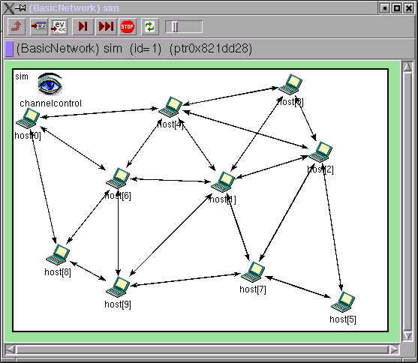
Simulation (NS2, OPNET…)
Pros:
Scalable
Cost effective
Cons:
Not a real equipment
Not a “hands on”
Simulation tools are complex
8

Slide 9
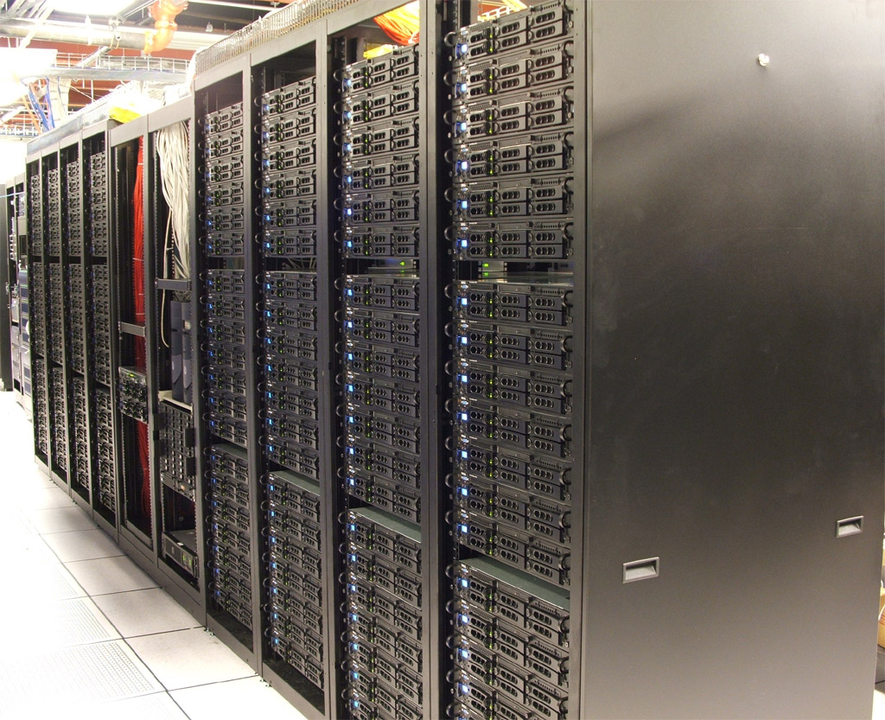
Related Work
Physical (real) lab
Simulation
Emulabs
Virtualization (MLN, VMware, Virtual PC)
9

Slide 10
Virtualization
One physical machine
Many independent operating systems
Operating system = Virtual machine
Virtualization Platforms:
Virtual PC
VMware
Xen

Slide 11
Virtualization Benefits
Increase utilization
Lower number of physical machines
Simple management
Isolation
Different operating systems on a single computer
11
Notes:
11
Increase utilization
Lower number of physical servers
reduce hardware maintenance costs and the energy saving
Isolation
prevent one application from impacting another. If we want to isolate some applications (or just test some unstable application), we can easily run them on different virtual machines
Virtual machine can be easily duplicated
speed up server deployment
Different operating systems on a single physical machine
Linux, Windows,...

Slide 12
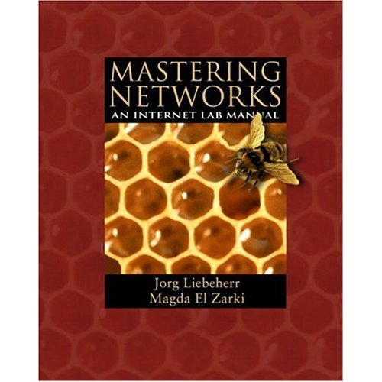
Virtual Lab Design
“Mastering Networks” book of Liebeher and El Zakri
Set of equipment:
4 PCs
4 Routers
8 Switches
We call this set - NetLab

Slide 13
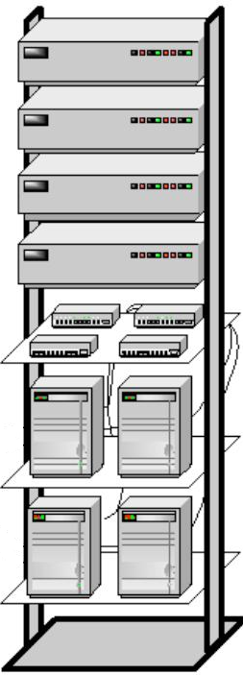
Virtual Lab Design
Instead of real NetLabs – virtual NetLabs
Single physical server
Virtualization platform - Xen
15 Virtual NetLabs
Xen allows many VM
Xen is freeware

Slide 14
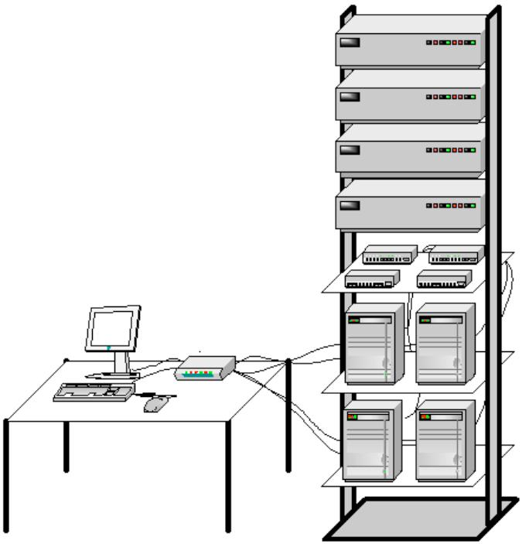
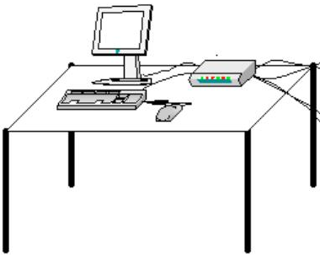
Students’ Perspective
Almost the same as real

Slide 15
Students’ Perspective
Anytime, anywhere
Laboratory
Campus
Home

Slide 16
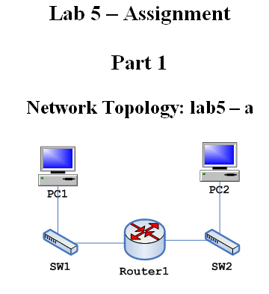
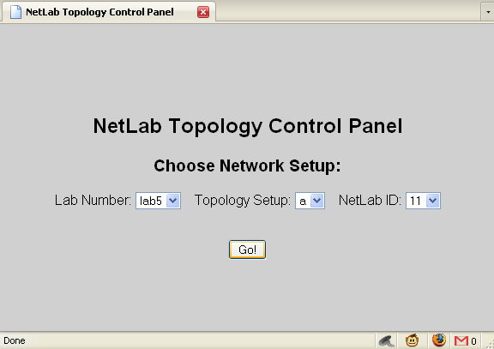
Students’ Perspective
Building Networks

Slide 17
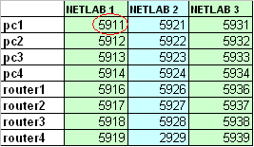
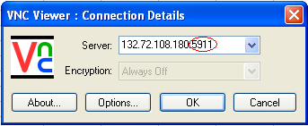
Students’ Perspective
Access
Virtual device – unique display number
Remote access - VNC

Slide 18
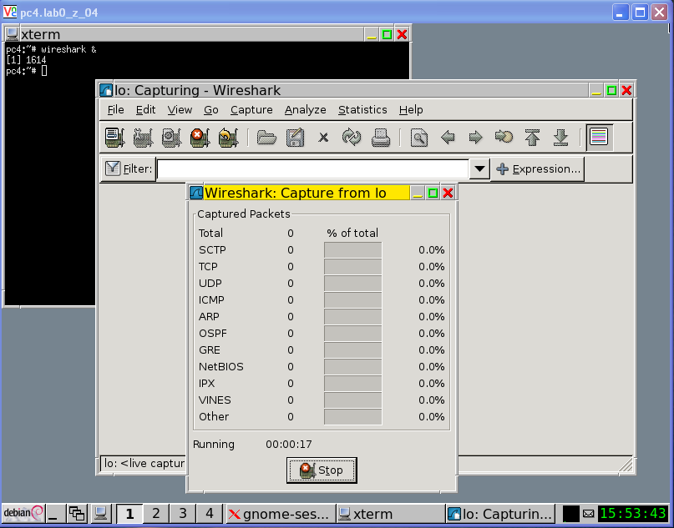
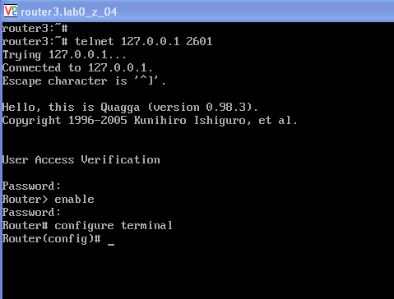
Students’ Perspective
Virtual PC
Linux OS
Graphical Desktop
Virtual Router
Linux OS
Quagga
CISCO like

Slide 19
Administrator’s Perspective
Topologies Preparation
Simple text file defines the topology
Administrator
Student
Remote troubleshooting
Restore VNC displays
Restart machines
Replace damaged machines

Slide 20
Extended Topologies
Physical Lab – Small Networks
Virtual Lab – Any Networks
BGP lab
Multicast lab

Slide 21
System Features
Capacity – more than 200 virtual machines (15 NetLabs)
Flexibility – any network topology
Remote Access – anytime, anywhere
Simple Administration
Fast Failure Recovery - everyone can be a “root”
In class lab sessions
Open Source/Freeware Software

Slide 22
Lab Implementation
Equipment
One Physical Server
Staff
Linux Specialist
Install Linux, Xen, Virtual Machines
Lab Administrator
Basic Linux and Networks knowledge
Lab Instructor
Networking and Linux knowledge

Slide 23
Conclusions & Future Work
Conclusions
Excellent students’ feedbacks
Almost full “hands on” lab
Saving cost, space, time and energy
Easy administration
Future work
Further experiments developing
Increase system capacity
Graphical interface to create topologies

Slide 24
Thank You!

Slide 25
System Architecture
Single HW server
Intel Xeon Quad Core CPU x 2
16 GB RAM
Hard Disks 250 GB x 4
Virtualization
Virtualization Platform - Xen
Hosting OS – Debian Linux 4.0
Guest OSs (Virtual Machines) – Debian Linux 4.0
64 MB RAM
Quagga Routing Suite
Packet Tracing Software: Tcpdump, Wireshark

